Slide 1
Spam detection using Naïve Bayes Classification Algorithm
Probability Models (BANA 7031) Final Project Ashish Saxena

Slide 2
Index
Introduction to Bayes Theorem
Naïve Bayes Classifier – Under the Hood
Problem Statement
Problem Definition
Executive Summary
Exploratory Data Analysis
Appendix
R Code (Embedded) & Dataset Link

Slide 3
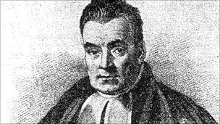

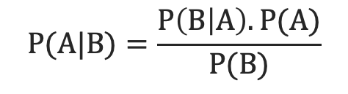

Introduction to Bayes Theorem
Named after Thomas Bayes
Describes the probability of occurrence of an event, based on prior conditions that might be related to the event
Thomas Bayes
(Source: BBC.com)
$$P(A|B)=\frac{P\left(B | A\right).P(A)}{P(B)}$$
Where,
P(A|B): Probability of occurrence of event A given event B has already occurred (posterior probability)
P(B|A) : Probability of occurrence of event B given event A has already occurred
P(A): Probability of occurrence of event A
P(B): Probability of occurrence of event B
$$P\left(A | B\right)=\frac{P\left(A∩B\right)}{P\left(B\right)} , P\left(B\right) ≠ 0$$
$$P\left(B | A\right)=\frac{P\left(B∩A\right)}{P\left(A\right)} , P\left(A\right) ≠ 0$$

Slide 4
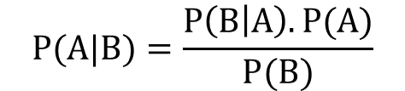
Introduction to Bayes Theorem
What does it mean?
$$P(A|B)=\frac{P\left(B | A\right).P(A)}{P(B)}$$
If, for two events, conditional probability for any one event over other is defined, the conditional probability of the second over the first can be calculated given marginal probabilities of each event
How is it useful?
It can helpful in categorizing new elements into specific buckets based on information from existing elements in each bucket

Slide 5





Introduction to Bayes Theorem
Predicting Play based on Weather Conditions of past two weeks
Weather | Play
Sunny | No
Overcast | Yes
Rainy | Yes
Sunny | Yes
Sunny | Yes
Overcast | Yes
Rainy | No
Rainy | No
Sunny | Yes
Rainy | Yes
Sunny | No
Overcast | Yes
Overcast | Yes
Rainy | No
Weather | Play - No | Play - Yes
Overcast |  | 4 | = 4/14 | 0.29
Rainy | 3 | 2 | = 5/14 | 0.36
Sunny | 2 | 3 | = 5/14 | 0.36
All | 5 | 9
 | = 5/14 | = 9/14
 | 0.36 | 0.64
$$P(Play−Yes|Sunny)=\frac{P\left(Sunny | Play−Yes\right).P(Play−Yes)}{P(Sunny)}$$
$$P(Play−Yes|Sunny)=\frac{(3/9).(9/14)}{5/14}$$
$$P(Play−No|Sunny)=\frac{(2/5).(5/14)}{5/14}$$
$$=\frac{3}{5}$$
$$=\frac{2}{5}$$

Slide 6
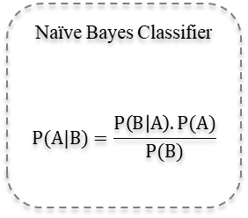

Naïve Bayes Classifier – Under the Hood
Works on the underlying principle of Bayes Theorem
Helps predict probability of an element belonging to a category basis its attributes
Training
Testing
Naïve Bayes Classifier
$$P(A|B)=\frac{P\left(B | A\right).P(A)}{P(B)}$$
Naïve Bayes Classifier
$$P(A|B)=\frac{P\left(B | A\right).P(A)}{P(B)}$$
Assumptions
All predictor variables are independent and do not impact occurrence of each other
All predictor variables hold equal importance in the prediction of response variable

Slide 7
Naïve Bayes Classifier – Under the Hood
PROS
CONS
Simple, fast, and very effective
Does well with noisy and missing data
Requires relatively few examples for training, but also works well with very large numbers of examples
Easy to obtain the estimated probability for a prediction
Relies on an often-faulty assumption of equally important and independent features
Not ideal for datasets with many numeric features
Estimated probabilities are less reliable than the predicted classes

Slide 8
Problem Statement
Telecom company J-Mobile has a base of over 50 million customers who receive spam messages on a regular basis from marketing teams of several companies
These messages are sent from business accounts for which the company charges a higher tariff value to its advertisers for each sent message
The company has recently noticed spam messages being sent from individual mobile numbers and wants to flag such messages sent to its customers on its own network to monetize better

Slide 9
Problem Definition
Current State
Desired State
J-Mobile is a telecom company with 50 million customers
It charges certain specific amount for spam messages sent through its network
The company wants to identify spam messages sent to customers to monetize better
Gap
Outcome: J-Mobile is able to achieve its monetization targets
Behavior: J-Mobile is able to implement desired monetization strategy
Insight: J-Mobile was able to identify spam messages sent to its customers
J-Mobile does not have a spam detection framework in place
Key Question
How are spam messages different from non-spam messages?

Slide 10



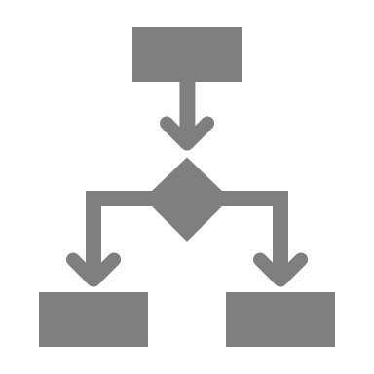
Executive Summary
The created spam detection model had an accuracy of 98.15%
The model exhibited a specificity of 89.62% thereby detecting correctly approximately 89 of every 100 spam messages
The sensitivity of the model was observed to be 99.38% implying accurate detection of almost all non-spam messages
The AUC value of the classification model was observed to be 0.9871 indicating high distinguishing capability between the classes

Slide 11
Exploratory Data Analysis & Results

Slide 12
Over 13% of the messages sent to customers were spam messages
Of the 5,572 messages in the dataset, 747 messages were observed as spam messages
The non-spam (ham) messages were observed to constitute over 86% of the total messages

Slide 13
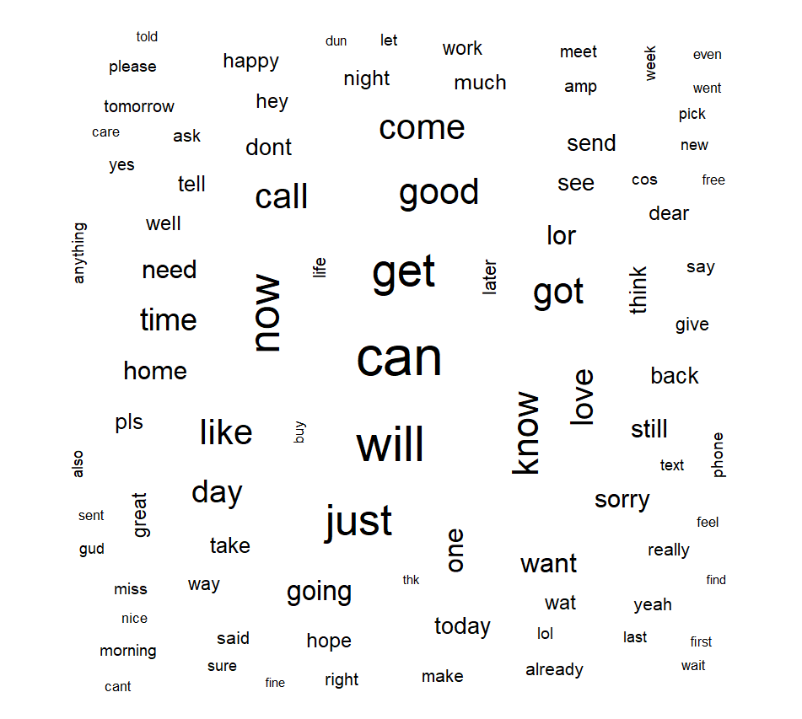
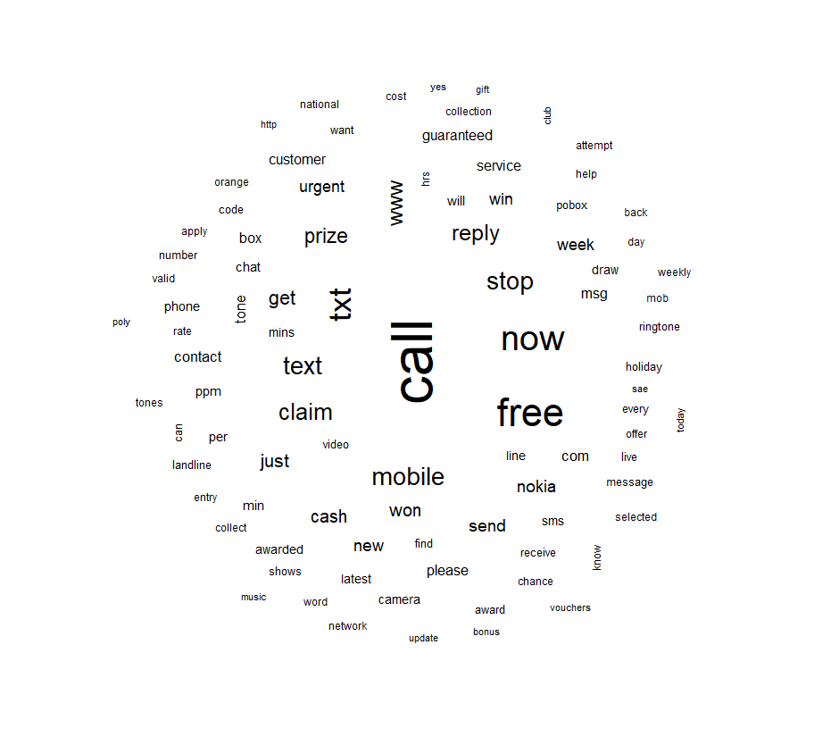
Frequent keywords across spam and non-spam messages differed significantly with few common keywords
Ham (Non-Spam)
Spam
While keywords across spam and non-spam messages differed significantly, common keywords included words like ‘call’, ‘now’ with varied frequencies across the two

Slide 14
Text messages received were processed for model infeed by removing numerical predictors, whitespace and implementing keyword stemming
Message
Removing stop words
Model infeed
Conversion to keywords
Stemming
Removing numbers
Removing whitespace
Lowercase conversion
Removing punctuations
While most of the pre-processing involved basic text mining operations, the final step used stemming
Stemming is used to associate different forms of a verb to a single root verb
For example, ‘running’, ‘ran’, ‘runs’ are converted to the root verb ‘run’

Slide 15

Keywords occurring below a specific frequency threshold were removed to enable effective model training simultaneously reducing training time
Bag of Keywords
Reduced bag of Keywords
Trailing keywords filtered
Threshold Frequency: 5
The keyword pool was filtered for a threshold frequency thereby reducing the number for training and testing datasets
This would lead to effective model training with reduced training time

Slide 16
A Document-Term matrix of the obtained keywords revealed the existence of keywords along with their prior categorization
Terms
 | KW₁ | KW₂ | KW₃ | KW₄ | KW₅ | … | KW_{n}
Msg 1 | Yes | No | Yes | Yes | No | … | Yes
Msg 2 | No | No | Yes | No | Yes | … | No
Msg 3 | Yes | No | Yes | Yes | No | … | Yes
Msg 4 | No | Yes | No | Yes | Yes | … | Yes
Keywords
Documents
Messages
The obtained terms (keywords) in each document (message) were converted to a document-term matrix for model training
Since Naïve Bayes classifier works on categorical data, all frequencies of the occurrence were converted into their categorical equivalents (“Yes” or “No) based on presence

Slide 17
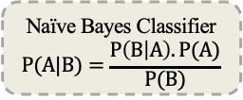
The Naïve Bayes classifier trained on the obtained data and further tested revealed encouraging performance statistics
Performance Statistics
Training Data
Naïve Bayes Classifier
$$P(A|B)=\frac{P\left(B | A\right).P(A)}{P(B)}$$
 | Reference (Ham) | Reference (Spam)
Predicted (Ham)
Predicted (Spam)
Accuracy = 98.15%
Sensitivity = 99.38%
Specificity = 89.62%
Testing
Data
1,451
22
Trained Model
9
190
Performance Statistics
Confusion Matrix
The performance statistics of the resultant model exhibited an accuracy of 98.15% in detecting spam messages
The sensitivity (Ham-detection capability) of the model was 99.38% with specificity (Spam-detection capability) of 89.62%

Slide 18
Appendix

Slide 19
The Naïve Bayes classifier trained on the obtained data and further tested revealed encouraging performance statistics
The AUC value of the classification model was observed to be 0.9871 indicating high distinguishing capability between the classes

Slide 20
R Code & Dataset link
R Code:
Dataset : SMS Spam Collection Dataset

Slide 21
References
Is Naïve Bayes a Good Classifier for Document Classification? S.L. Ting, W.H. Ip, Albert H.C. Tsang
Bayes’ Theorem & Naïve Bayes Classifier Daniel Berrar
Naive Bayes Classifier Learning with Feature Selection for Spam Detection in Social Bookmarking Chanju Kim and Kyu-Baek Hwang

